Slide 1




Temporal Tables The New Hotness in Data Auditing
John Morehouse
Consultant
Denny Cherry & Associates Consulting
john@dcac.co
http://linkedin.com/in/sqlrus
@SqlRUs
http://www.sqlrus.com

Slide 2

Who Am I?
Leader of the Louisville SQL Server/Power BI User Group
Organizer/Speaker of SQL Saturday’s & other conferences
Heavily involved with SQL PASS
Microsoft Data Platform MVP
Friend of Redgate 2015 - 2018
Idera ACE 2016
SentryOne Product Advisory Council

Slide 3
Where Am I?
The vetted and certified experts at Denny Cherry and Associates Consulting assist companies with attaining IT goals such as HA, scalability, SQL Server virtualization, migration, and acceleration reliably while finding ways to save on costs. With clients ranging from Fortune 50 corporations to small businesses, their commitment to each is the same: to provide a deft, high-speed IT environment that leverages every aspect of their platform: from architecture, infrastructure, to network.
Visit DCAC at http://www.dcac.co

Slide 4

Quick Check
How many:
DBA’s
Developers
BI/DWH
Other
Please make sure to fill out evaluations
Ask questions!!!

Slide 5


Stop me if you’ve heard….
I want to be able to save everything for all time, including all data changes.
Notes:
I can’t count how many times I’ve heard a business owner tell me this, expecting a simple switch to solve all of their problems.

Slide 6
Old Hotness
Triggers
Change Data Capture
Database architecture
Notes:
Change Data Capture - fragile, can be difficult to restore if you don’t use the KEEP_CDC option. Meant for scraping off the system tables into a long term archival process.
Triggers – hundreds of tables? Can be performance disadvantage. Lengthy triggers make it difficult to maintain code base
Built-in – architect the solution to facilitate keeping history without the use of triggers, cdc, temporal tables.
Use the FCSA decision engine as an example. Stored decisions as XML and any change caused the application to go back to through the application

Slide 7
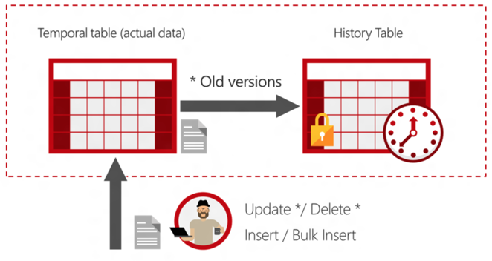
New Hotness
SQL Server 2016+
On-prem/Azure SQL DB
All editions
Transparent
Easier to implement
Notes:
Temporal – relating to time
A system-versioned temporal table is a new type of table available in SQL Server 2016. These tables are designed to keep a full history of data changes and allow for developers to perform easy point in time analysis on their data. The period of validity for each row is managed by the system, no user interaction is required. Each of these tables has two explicitly defined columns which are referred to as period columns, they are exclusively used by the system to record validity data.
A second table called a history table is created, SQL Server uses this table to store the previous version of a record every time the row is updated or deleted. Users can allow the history table to be created dynamically or specify an existing table, as long as the table is schema compliant.

Slide 8
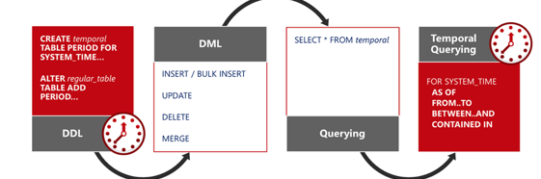
Temporal Tables
Notes:
Create a history table or temporal table
Alter the exiting table to track the history
Perform some DML statement, which modifies the data
NOTE: A new row is inserted into this History table when it is no longer valid in the main table, because it has just been deleted or changed. Initial insert won’t put the row into the history table
We can see the data lineage by querying from the temporal table

Slide 9
When to use Temporal Tables?
Auditing all data changes/forensics
Reconstructing data from the past
Calculating trends over time
Slowly changing dimensions
Recovering from accidental data deletion
Notes:
While there are many use cases that are obvious for temporal tables, there are a few that are less so. Many business scenarios require the calculation of trends over time, this is greatly simplified with temporal. Also, these tables can be used for data protection—if a user or developer accidentally deletes key records from an important table, they can be rebuilt.

Slide 10
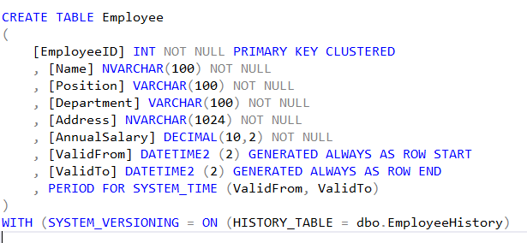
Creating a Temporal Table
Temporal Tables require the use of a primary key
On insert SQL sets value for SysStartTime to begin time of the current transaction
On update SQL moves previous record to history table and marks record as closed
Deletes stores previous value in history table and marks record as closed
System Versioning keyword sets temporal on
Notes:
System-versioning for a table is implemented as a pair of tables, a current table and a history table. Within each of these tables, the following two additional datetime2 columns are used to define the period of validity for each record:
Period start column: The system records the start time for the row in this column, typically denoted as the SysStartTime column.
Period end column: The system records the end time for the row in this column, typically denoted at the SysEndTime column.
The current table contains the current value for each row. The history table contains each previous value for each row, if any, and the start time and end time for the period for which it was valid
Datetime2 (2) = 2 represents fractional seconds precision
6 bytes for precisions less than 3; 7 bytes for precisions 3 and 4. All other precisions require 8 bytes.

Slide 11
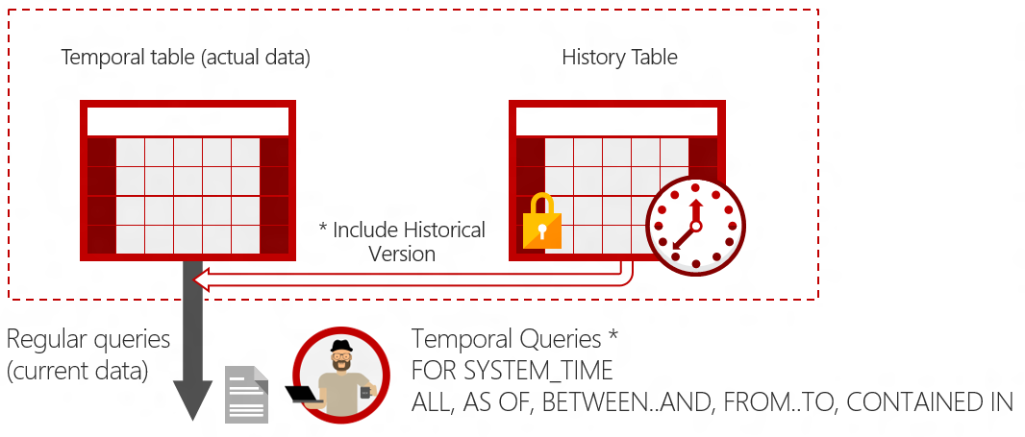

Querying Temporal Data
ALL
AS OF
BETWEEN…AND
FROM…TO
CONTAINED IN
Notes:
The SELECT statement FROM <table> clause has a new clause FOR SYSTEM_TIME with five temporal-specific sub-clauses to query data across the current and history tables. This new SELECT statement syntax is supported directly on a single table, propagated through multiple joins, and through views on top of multiple temporal tables. The five sub clauses are:
ALL
AS OF
BETWEEN..AND
FROM..TO
CONTAINED IN
Optionally, you can choose to hide these period columns such that queries that do not explicitly reference these period columns do not return these columns (the SELECT * FROM <table> scenario). To return a hidden column, simply explicitly refer to the hidden column in the query. Similarly INSERT and BULK INSERT statements will continue as if these new period columns were not present (and the column values will be auto-populated).

Slide 12
Query Qualifiers
AS OF <date_time>
FROM <start_date_time> TO <end_date_time>
BETWEEN <start_date_time> AND <end_date_time>
CONTAINED IN (<start_date_time>,<end_date_time>)
ALL
Notes:
AS OF - Returns a table with a rows containing the values that were actual (current) at the specified point in time in the past. Internally, a union is performed between the temporal table and its history table and the results are filtered to return the values in the row that was valid at the point in time specified by the <date_time> parameter. The value for a row is deemed valid if the system_start_time_column_name value is less than or equal to the <date_time> parameter value and the system_end_time_column_name value is greater than the <date_time> parameter value.
FROM - Returns a table with the values for all row versions that were active within the specified time range, regardless of whether they started being active before the <start_date_time> parameter value for the FROM argument or ceased being active after the <end_date_time> parameter value for the TO argument. Internally, a union is performed between the temporal table and its history table and the results are filtered to return the values for all row versions that were active at any time during the time range specified. Rows that ceased being active exactly on the lower boundary defined by the FROM endpoint are not included and records that became active exactly on the upper boundary defined by the TO endpoint are not included also.
BETWEEN …. AND … - Same as above in the FOR SYSTEM_TIME FROM <start_date_time>TO<end_date_time> description, except the table of rows returned includes rows that became active on the upper boundary defined by the <end_date_time> endpoint.
CONTAINED IN - Returns a table with the values for all row versions that were opened and closed within the specified time range defined by the two datetime values for the CONTAINED IN argument. Rows that became active exactly on the lower boundary or ceased being active exactly on the upper boundary are included.
ALL - Returns the union of rows that belong to the current and the history table.

Slide 13
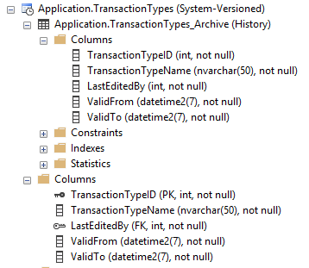
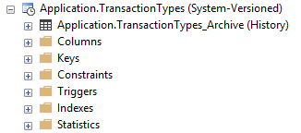
Object Explorer Changes
Notes:
The history table is under the main table for easy identification
The icon next to the table also changed
Object Explorer informs us that the table is System-Versioned. Easily to identify
Note: the history table can have it’s own constraints, indexes, and statistics

Slide 14
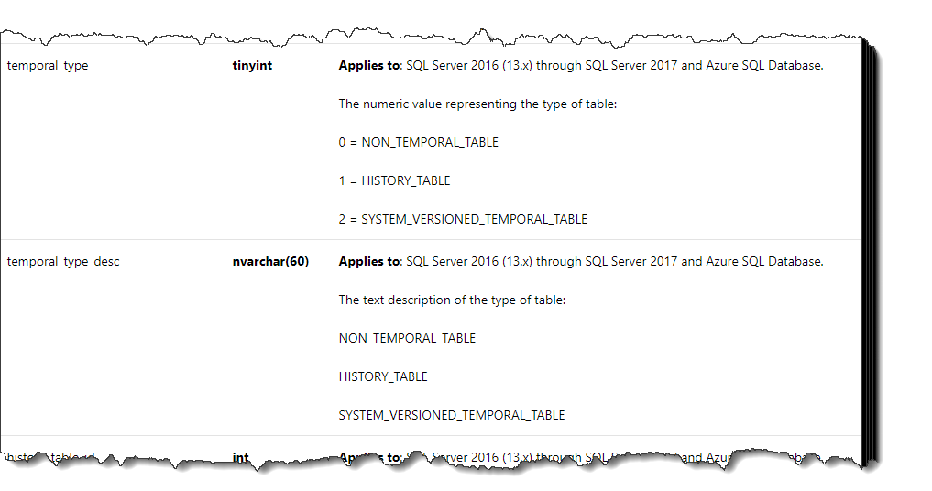
Updates to sys.tables

Slide 15
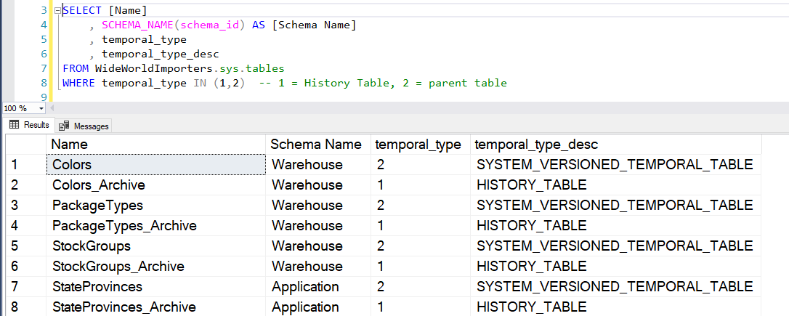
Updates to sys.tables
Notes:
This allows us to easily query system tables to determine which tables are system versioned.

Slide 16
Data Purging
Partitioning
Retention Policies
SQL Server 2017 CP1
Custom Scripts
Must turn off system versioning
Lock the table!
Notes:
Need to add a demo on purging data as well as rebuilding deleted data

Slide 17
Need space
Stretch Tables!

Slide 18


Slide 19
Temporal Table Considerations
By default history tables are page compressed
History table must be in same database is base table
Truncate table is not supported
ON DELETE CASCADE and ON UPDATE CASCADE are not supported
Always On Availability Groups are supported
Change Data Capture and Change Tracking Supported on the base table only
Columnstore indexes are supported for both tables
In-Memory is supported
Notes:
Columnstore is supported with the compression
Uses page compression
Replication is support in a limited basis. Always On supported. Merge replication not supported. Transactional replication as long as single publisher without temporal tables and a subscriber with temporal tables enabled on the subscriber
Watch out for blob data types. They are supported but you’ll incur a hit on storage costs
Can’t use filetable/filestream with temporal tables
Can use temporal tables in conjunction with CDC but only on the base table, not the history/archive table.
You can use partitioning
Current table you can switch in but not switch out
History table you can switch out but not in as it might invalidate data consistency

Slide 20
DBCC CHECKCONSTRAINTS
The names and number of columns is the same in both the current table and the history table.
The datatypes match for each column between the current table and the history table.
The period columns are set to NOT NULL.
The current table has a primary key constraint and the history table does not have a primary key constraint.
No IDENTITY columns are defined in the history table.
No triggers are defined in the history table.
No foreign keys are defined in the history table.
No table or column constraints are defined on the history table. However, default column values on the history table are permitted.
The history table is not placed in a read-only filegroup.
The history table is not configured for change tracking or change data capture.
Notes:
If you run dbcc check constraints against a table it will also check the temporal table requirements. Something to watch out for.

Slide 21

Questions

Slide 22
Resources
https://docs.microsoft.com/en-us/sql/relational-databases/tables/getting-started-with-system-versioned-temporal-tables?view=sql-server-2017
https://docs.microsoft.com/en-us/sql/relational-databases/tables/changing-the-schema-of-a-system-versioned-temporal-table?view=sql-server-2017
https://docs.microsoft.com/en-us/sql/relational-databases/tables/temporal-table-usage-scenarios?view=sql-server-2017
https://docs.microsoft.com/en-us/sql/relational-databases/tables/temporal-table-security?view=sql-server-2017
https://sqlperformance.com/2016/06/sql-server-2016/temporal-table-query-plan-behaviour

Slide 23
THANK YOU!!!!
john@dcac.co
http://linkedin.com/in/sqlrus
@SqlRUs
http://www.sqlrus.com

